Slide 1
Lesson 3.12
Leadership during an Emergency
CGPRT(W) : Ensuring Clean Seas and Coasts in Western Region ……

Slide 2
Objective
To understand the leadership qualities required in incident management.
To understand how to avoid common management failures.
CGPRT(W) : Ensuring Clean Seas and Coasts in Western Region ……

Slide 3
Introduction
Leadership
Leadership qualities
Appointing leaders
Management failures
Avoiding management failures
CGPRT(W) : Ensuring Clean Seas and Coasts in Western Region ……

Slide 4
Leadership
Irrespective of the structure of the response organization, the abilities of the leaders of the response will have an important bearing on the progress and outcome of the response.
CGPRT(W) : Ensuring Clean Seas and Coasts in Western Region ……

Slide 5
Leadership
Leadership qualities include the ability to:
command or manage personnel from a diverse range of organizations
listen and respond to the concerns and suggestions of the various parties
assimilate information from a wide range of sources
make timely decisions based on this information
CGPRT(W) : Ensuring Clean Seas and Coasts in Western Region ……

Slide 6
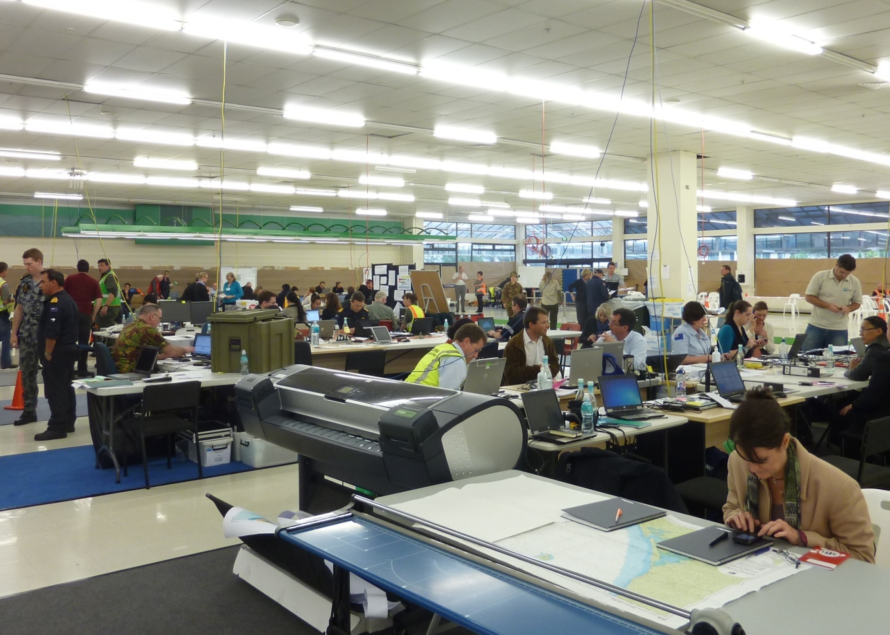
Command Centre
Source: ITOPF
CGPRT(W) : Ensuring Clean Seas and Coasts in Western Region ……

Slide 7
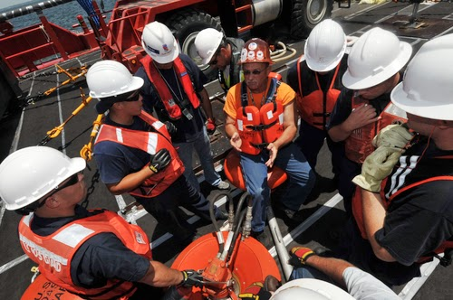
Field Operations
Source: US Coast Guard
CGPRT(W) : Ensuring Clean Seas and Coasts in Western Region ……

Slide 8
Leadership
Leadership qualities include the ability to:
set priorities
resolve conflicts
allocate limited resources
communicate decisions clearly
motivate team members
recognize team members’ limitations and reallocate tasks accordingly
CGPRT(W) : Ensuring Clean Seas and Coasts in Western Region ……

Slide 9
Leadership
Leadership qualities include the ability to:
ensure the response is technically reasonable
resist pressure from politicians, media and public to carry out unreasonable or dangerous activities
determine the termination criteria
reduce or terminate the response efforts when appropriate
CGPRT(W) : Ensuring Clean Seas and Coasts in Western Region ……

Slide 10
Appointing Leaders
Leaders should be appointed with:
prior relevant experience in a senior command or management position
appropriate to the level and intensity of the incident
technical posts need to be filled with technically skilled personnel
manager posts can be filled with non-technical personnel
CGPRT(W) : Ensuring Clean Seas and Coasts in Western Region ……

Slide 11
Appointing leaders
Long hours and intense pressures, especially during the initial stage of an incident, can lead to extreme fatigue and impaired judgment at all levels.
Deputies must be appointed to allow rest periods to be taken.
CGPRT(W) : Ensuring Clean Seas and Coasts in Western Region ……

Slide 12
Appointing Leaders
The qualities, qualifications and experience of the deputies should be similar to those they relieve.
Continuity should be preserved through hand-over briefings.
CGPRT(W) : Ensuring Clean Seas and Coasts in Western Region ……

Slide 13
Management Failures
Potential management failures that have been observed at incidents:
ineffective leadership at critical times
ineffective communications and delays in sharing information
failure to provide timely procedures
poor training and supervision of employees
ineffective management and oversight of contractors
inadequate use of technology
failure to appropriately analyse and appreciate risk
CGPRT(W) : Ensuring Clean Seas and Coasts in Western Region ……

Slide 14
Avoiding Management Failures
Some or all of these remarks can be apportioned to many incidents.
Each incident will differ in size and complexity.
A pre-requisite for operational success is to establish an organizational structure scaled appropriately to the situation.
The organization must have effective leadership and management.
CGPRT(W) : Ensuring Clean Seas and Coasts in Western Region ……

Slide 15
Avoiding Management Failures
This structure needs to be tested regularly and thoroughly through a series of exercises.
The structure needs to be capable of being scaled up and down as appropriate.
A thorough understanding of the roles and responsibilities of each function in the command structure promotes coordination and communication.
CGPRT(W) : Ensuring Clean Seas and Coasts in Western Region ……

Slide 16
Avoiding Management Failures
Clear and open lines of communication are vital to minimize confusion and delays.
Mechanisms to manage volunteers, media demands and offers of assistance need to be established.
Lessons from incidents, training or exercises need to be learned and acted upon.
CGPRT(W) : Ensuring Clean Seas and Coasts in Western Region ……

Slide 17
Summary
In this lesson we have considered the leadership qualities required in incident management.
We have also looked at some common management failures and how we might avoid them.
CGPRT(W) : Ensuring Clean Seas and Coasts in Western Region ……

Slide 18
Any questions?
CGPRT(W) : Ensuring Clean Seas and Coasts in Western Region ……

